Slide 1


Plant Communication System with microprocessor interfacing
A project for Microprocessor and Interfacing
Review 1
By:
Rachit Saxena 20BCE2322
Nida Ghani 20BCE2850
Shiva Ramakrishna 20BCE2864

Slide 2

Problem Statement
We all know that houseplants are good for our health. They not only freshen up the air, but also eliminate harmful toxins. Keeping your plants alive can be quite the challenge as they are very bad at communication.
Moreover in the last few decades the pace of life has accelerated and become as fast as never before. This is where the problem arises, because of our fast paced and busy life, we often forget to take care of our plants

Slide 3
Solution
Creating a communication tool that allows the interactors to perceive what the status of a plant is at a given point in time with the help of relevant microprocessors, microcontrollers and sensors.
The tool expresses factors such as the humidity levels, moisture levels and exposure to sunlight by using an LCD display screen and an LED dot matrix.
It stores the data sets perceived and defines the status of the plant by taking an average of the relevant parameters.
This way the user can always tell when they need to take better care of the plant.

Slide 4
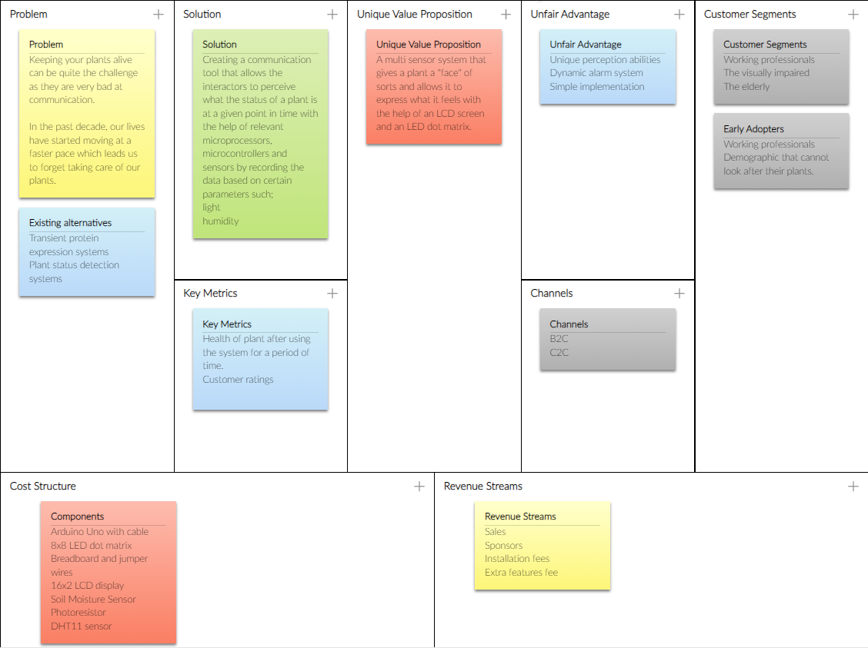
Lean Chart

Slide 5
Unique Value Proposition
It is a system that is designed to express what a plant feels or, in a way, gives them a face to express their needs.
Design and Implementation of the project with Arduino.
Displaying the parameters to keep the plant in good condition.

Slide 6
Objectives
In this project , we plan to build a plant communication system, which will help us keep a check on the plant needs. It will tell us if the plant is facing any difficulties so that we can help it as soon as possible.
We plan to accomplish the following at the end of this project.
a. Understand the working of the various sensors used in our project.
b. Study about the various Merits and Demerits of the sensors used.
c. Have a basic idea about Arduino and its working
d. Learn more about coding in the Arduino IDE with C language
e. Learn about the various conditions that the plants are most suitable to grow in
f. Construct the hardware model of the full plant communicator
With this we can provide our plants with a face, so that even the busiest
of people can find a little time to take care of their plants and make them
happy.

Slide 7
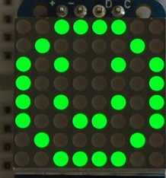
Methodology
The brains of our project will be an Arduino – Uno. It is actually a microcontroller with 14 digital I/O pins and 6 analog I/O pins. It can be programmed in C++ language.
All our Sensors, displays will be connected to the Arduino using the jumper cables and the breadboard. Our Code will be plant specific i.e. all the conditions (temperature, light intensity) will be based on a particular plant. This code will be compiled and uploaded to the Arduino with the Arduino IDE.
At first, all the data from the sensors will be collected, and displayed to the user one by one with a delay.
Each of the parameter will have a score from 1-3. Based on the conditions of the plant ,
the score will be higher/ lower. Finally the average score of all the parameters will be
taken, and the user will be shown the score. This score will help the user know exactly
how well they have taken care of the plant.
Now based on this score, the 8x8 LED Dot matrix will display a face.
If the score is high, It will show a smiling face , if the score is low,
it will show a sad face. This gives the plant
a “Face” to communicate.

Slide 8
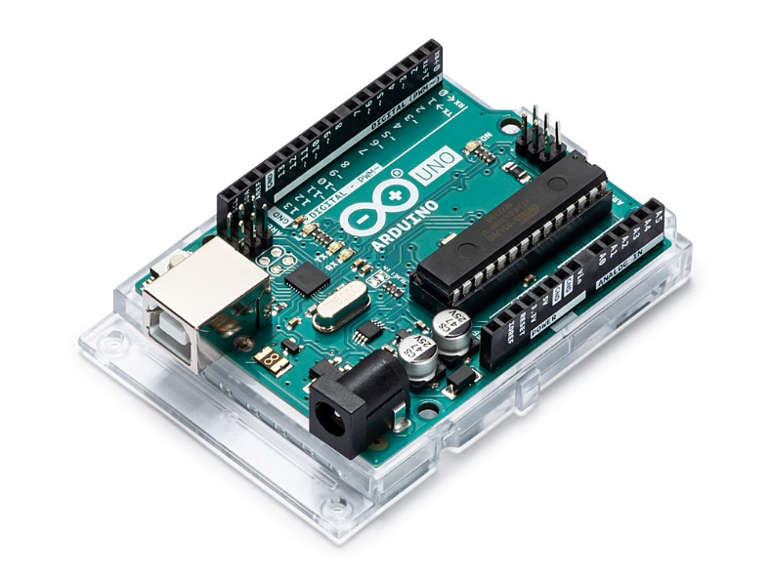
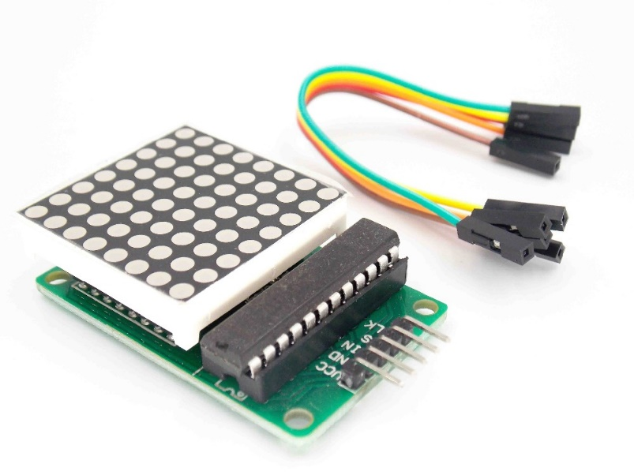
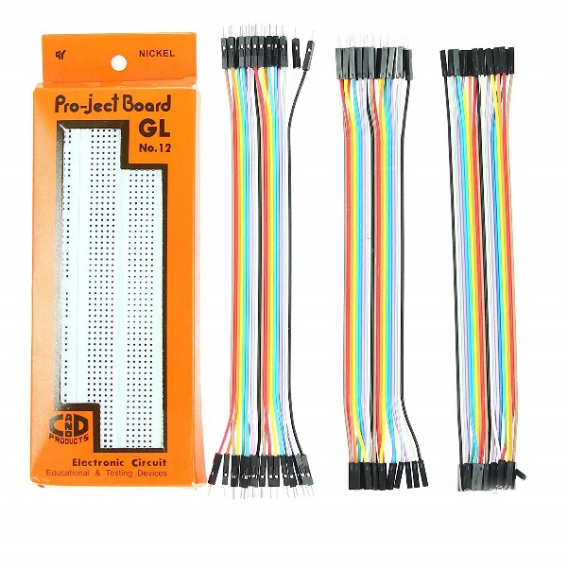
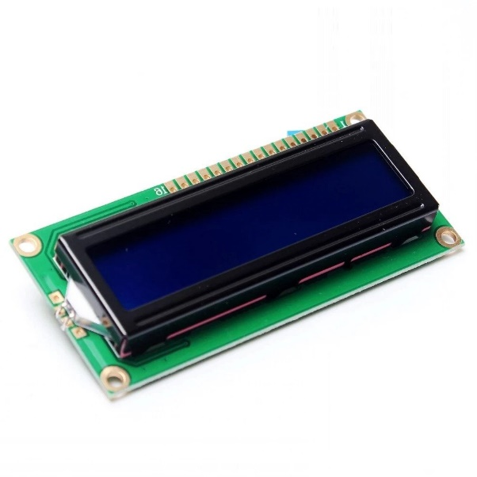
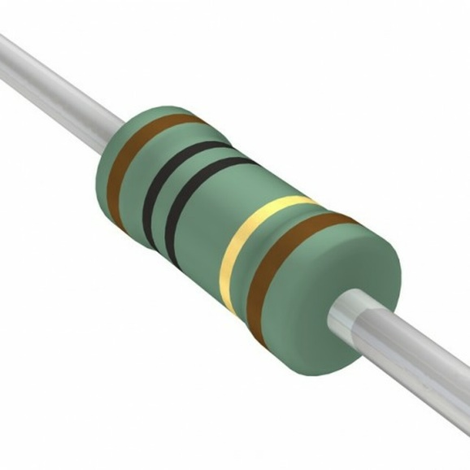
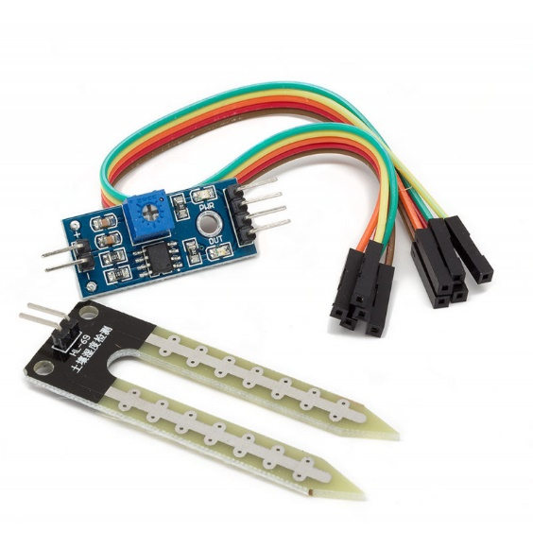
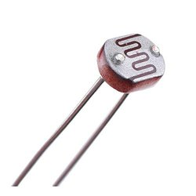
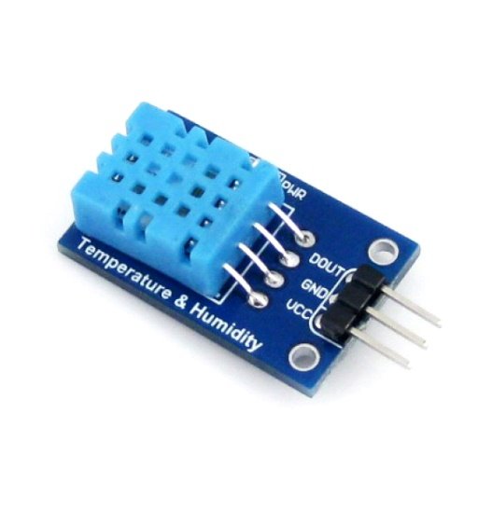
Components required
Arduino Uno with Cable
8x8 LED Dot matrix
Breadboard along with
Jumper Wires
16x2 LCD Display
10 K Ohm resistor
Soil Moisture Sensor
Photoresistor
DHT11 temperature
and Humidity sensor

Slide 9
Block Diagram
Sensor Data fetched every 5 sec
Soil Moisture
Sensor
Calculates the score of how good the plant is being taken care of
LCD Display
Will be used to Show Current Plant Condition
Temperature &
Humidity
Arduino
LED Dot Matrix
Light Intensity
Will be used to show a facial Expression

Slide 10
Literature Review
 | Name of the Author | Title
1 | Jonathan Gana Kolo | Design and construction of automatic power changeover system
2 | S. V. Devika, Sk. Khamuruddeen, Sk. Khamurunnisa, Jayanth Thota, Khalesha Shaik | Arduino Based Automatic Plant Watering System
Innovation
Design and Implementation of the project with Arduino
Display facial expressions on an 8x8 led matrix

